Slide 1
Life
Expectancy Analysis
Using Data Analytics and Machine Learning
MSBA FALL 2021 - Group 2
Yihusan Tseng, Mihir Kungulwar, Ziqi Liu,
Udisha Madnani, ChiaLing Ni

Slide 2
Introduction
WHO introduced healthy life expectancy as a summary measure of the level of health in the World Health Report 2000. It is important to assess whether life expectancy increases are associated with improved continued economic activity, dietary habits, education and other different factors among countries around the world.
The population of many of the richest countries in the world have life expectancies of over 80 years. However, the countries with the worst health life expectancy is between 50 and 60 years. We should be curious to know how life expectancy will change under different situation, and how it has improved during different time series.

Slide 3
Data Description:
Life Expectancy dataset from WHO was found on kaggle, the Global Health Observatory (GHO) data repository under World Health Organization (WHO) keeps track of the health status as well as many other related factors for all countries focuses on factors influencing Life Expectancy. The observations are based on different countries, including many kinds of immunizations, mortality, alcohol, economic, social factors, and other health related factors.
We also merge three datasets(Crime Index, Depression, Cannabis) to analyze from more perspectives. Based on the new dataset, we could analyze the influences on life expectancy of different factors. Investigating if the countries should pay more attention to some specific factors, or we could also see if life expectancy has a positive or negative relationship with some specific factors.
Depression
Alcohol
Crisis
Life Expectancy
From 2000-2015
+23 columns
+2835 rows
+177 countries

Slide 4
Methodology
1. Exploratory Analysis -
Find the correlation between variables
2. Diagnostic Analysis -
Think about why it happened
3. Predictive Analysis -
Build machine learning model
4. Prescriptive Analysis
Results and Conclusion

Slide 5
Our Findings
Will the legalization of cannabis for recreational use affect life expectancy given different crime rate?
How does alcohol consumption affect healthcare expenditure and life expectancy?
How does alcohol consumption affect healthcare expenditure and life expectancy?

Slide 6
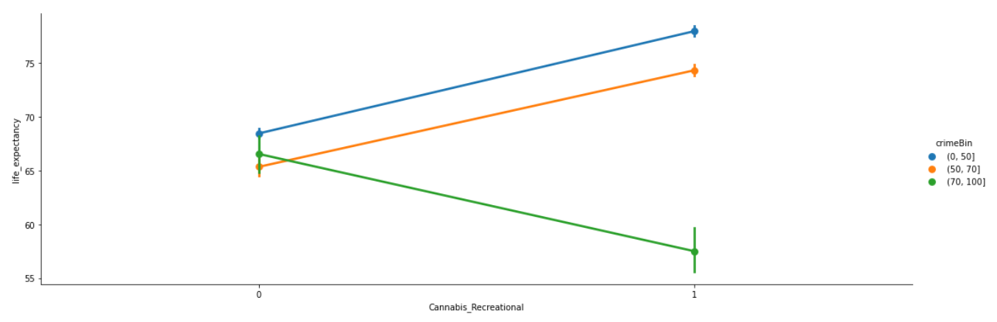
Will the legalization of cannabis for recreational use affect life expectancy given different crime rate?
Finding 1 : With the crime index below 70, the legalization of recreational use cannabis will increase life expectancy. However, if a country with higher crime index (>70) allowing the legalization of cannabis, life expectancy will drop.
Insight: Passing legalization of cannabis policy can help to improve citizens life expectancy if a country is comparatively safe. However, if a country has a high crime index, they probably need to prohibit cannabis for recreational use to maintain its life expectancy.

Slide 7
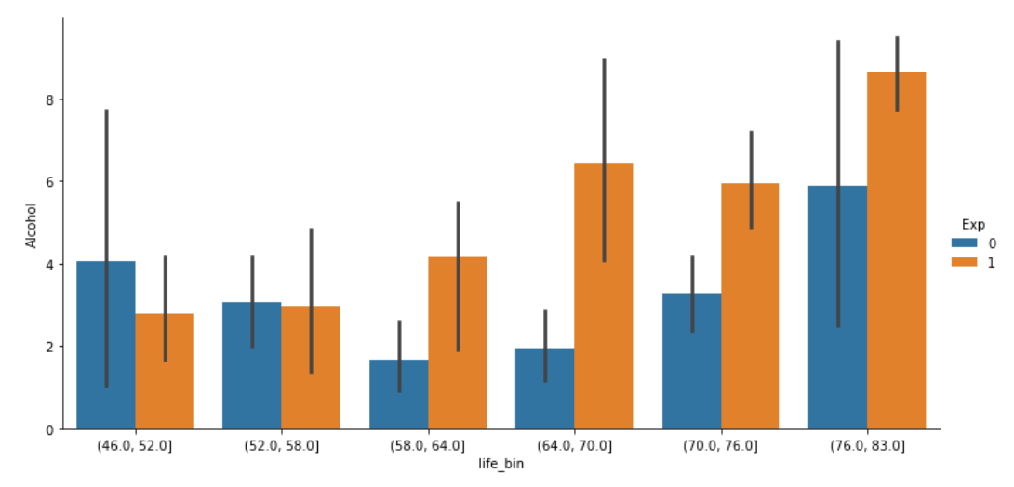
How does alcohol consumption affect healthcare expenditure and life expectancy?
Finding 2 : With increasing life expectancy, we notice an increase in alcohol consumption. For countries with life expectancy above 58, citizens in countries where government spends more on healthcare were seen to be drinking more.
Insight: The government should spend more on healthcare expenditure to increase life expectancy. On the other hand, increasing alcohol consumption does not have a negative impact on life expectancy. That is, drinking alcohol might not be an essential factor to affect longevity of life.

Slide 8
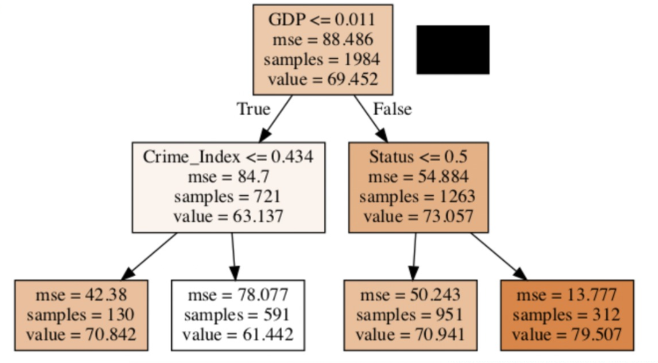
What’s the most important factor(s) affecting life expectancy?
Finding 3 : A country with higher GDP per capita, which is a developed country, will have a higher life expectancy. A country with lower GDP per capita and a higher crime index, will have a lower life expectancy.
Insight:
- For the developed countries, the government might want to focus on increasing the GDP in order to get a better life expectancy.
- For the developing countries, the government must act on reducing the crime index.

Slide 9

THANK YOU
MSBA FALL 2021 - Group 2

